Slide 1
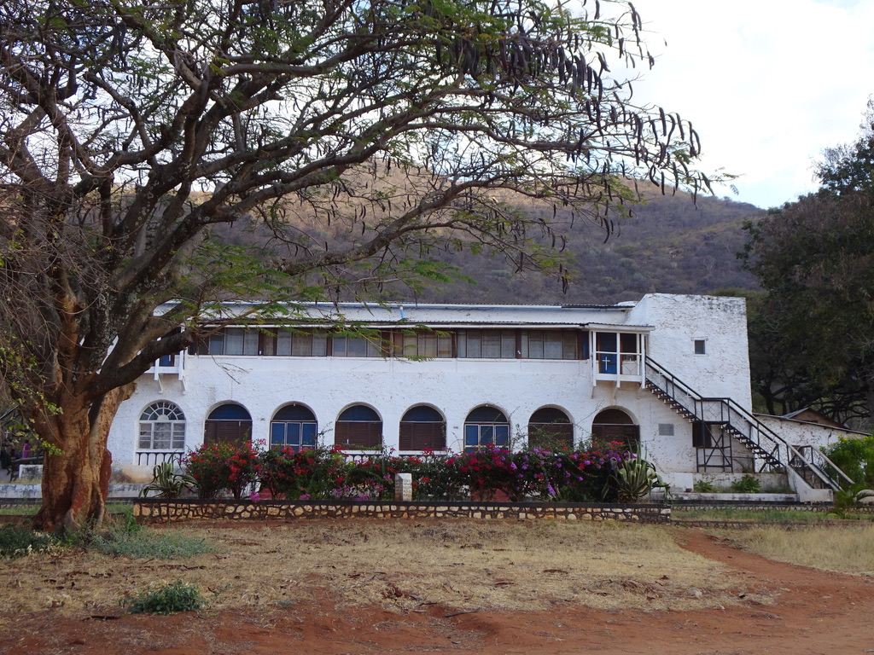

St Philips
College
Update
July 2023
S2g7

Slide 2

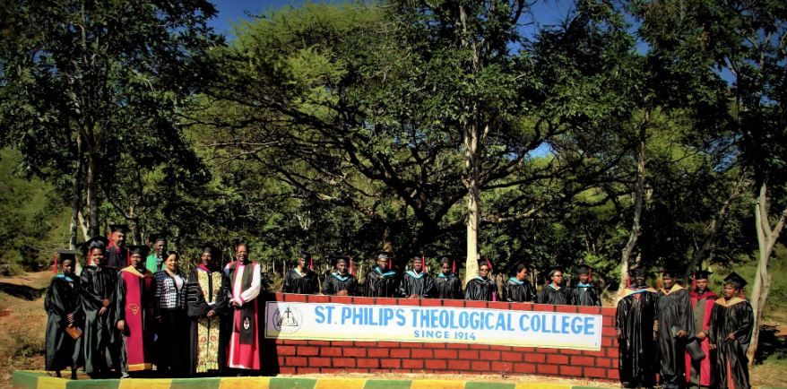
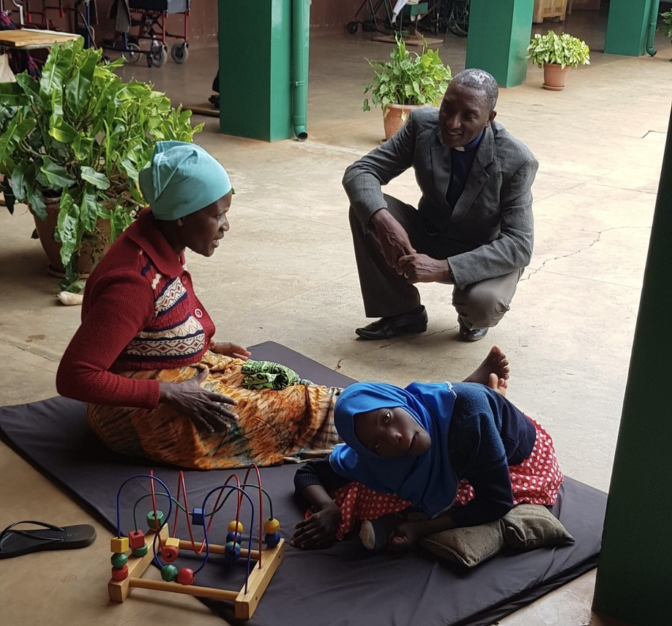
Rev Canon Agripa, Principal of St Philip’s Theological College, continues to develop the College, with diocesan bishops from across the Province recently attending and agreeing a plan to support the College.
An International Conference on Disability was also held at the college in June this year.
S2g7

Slide 3
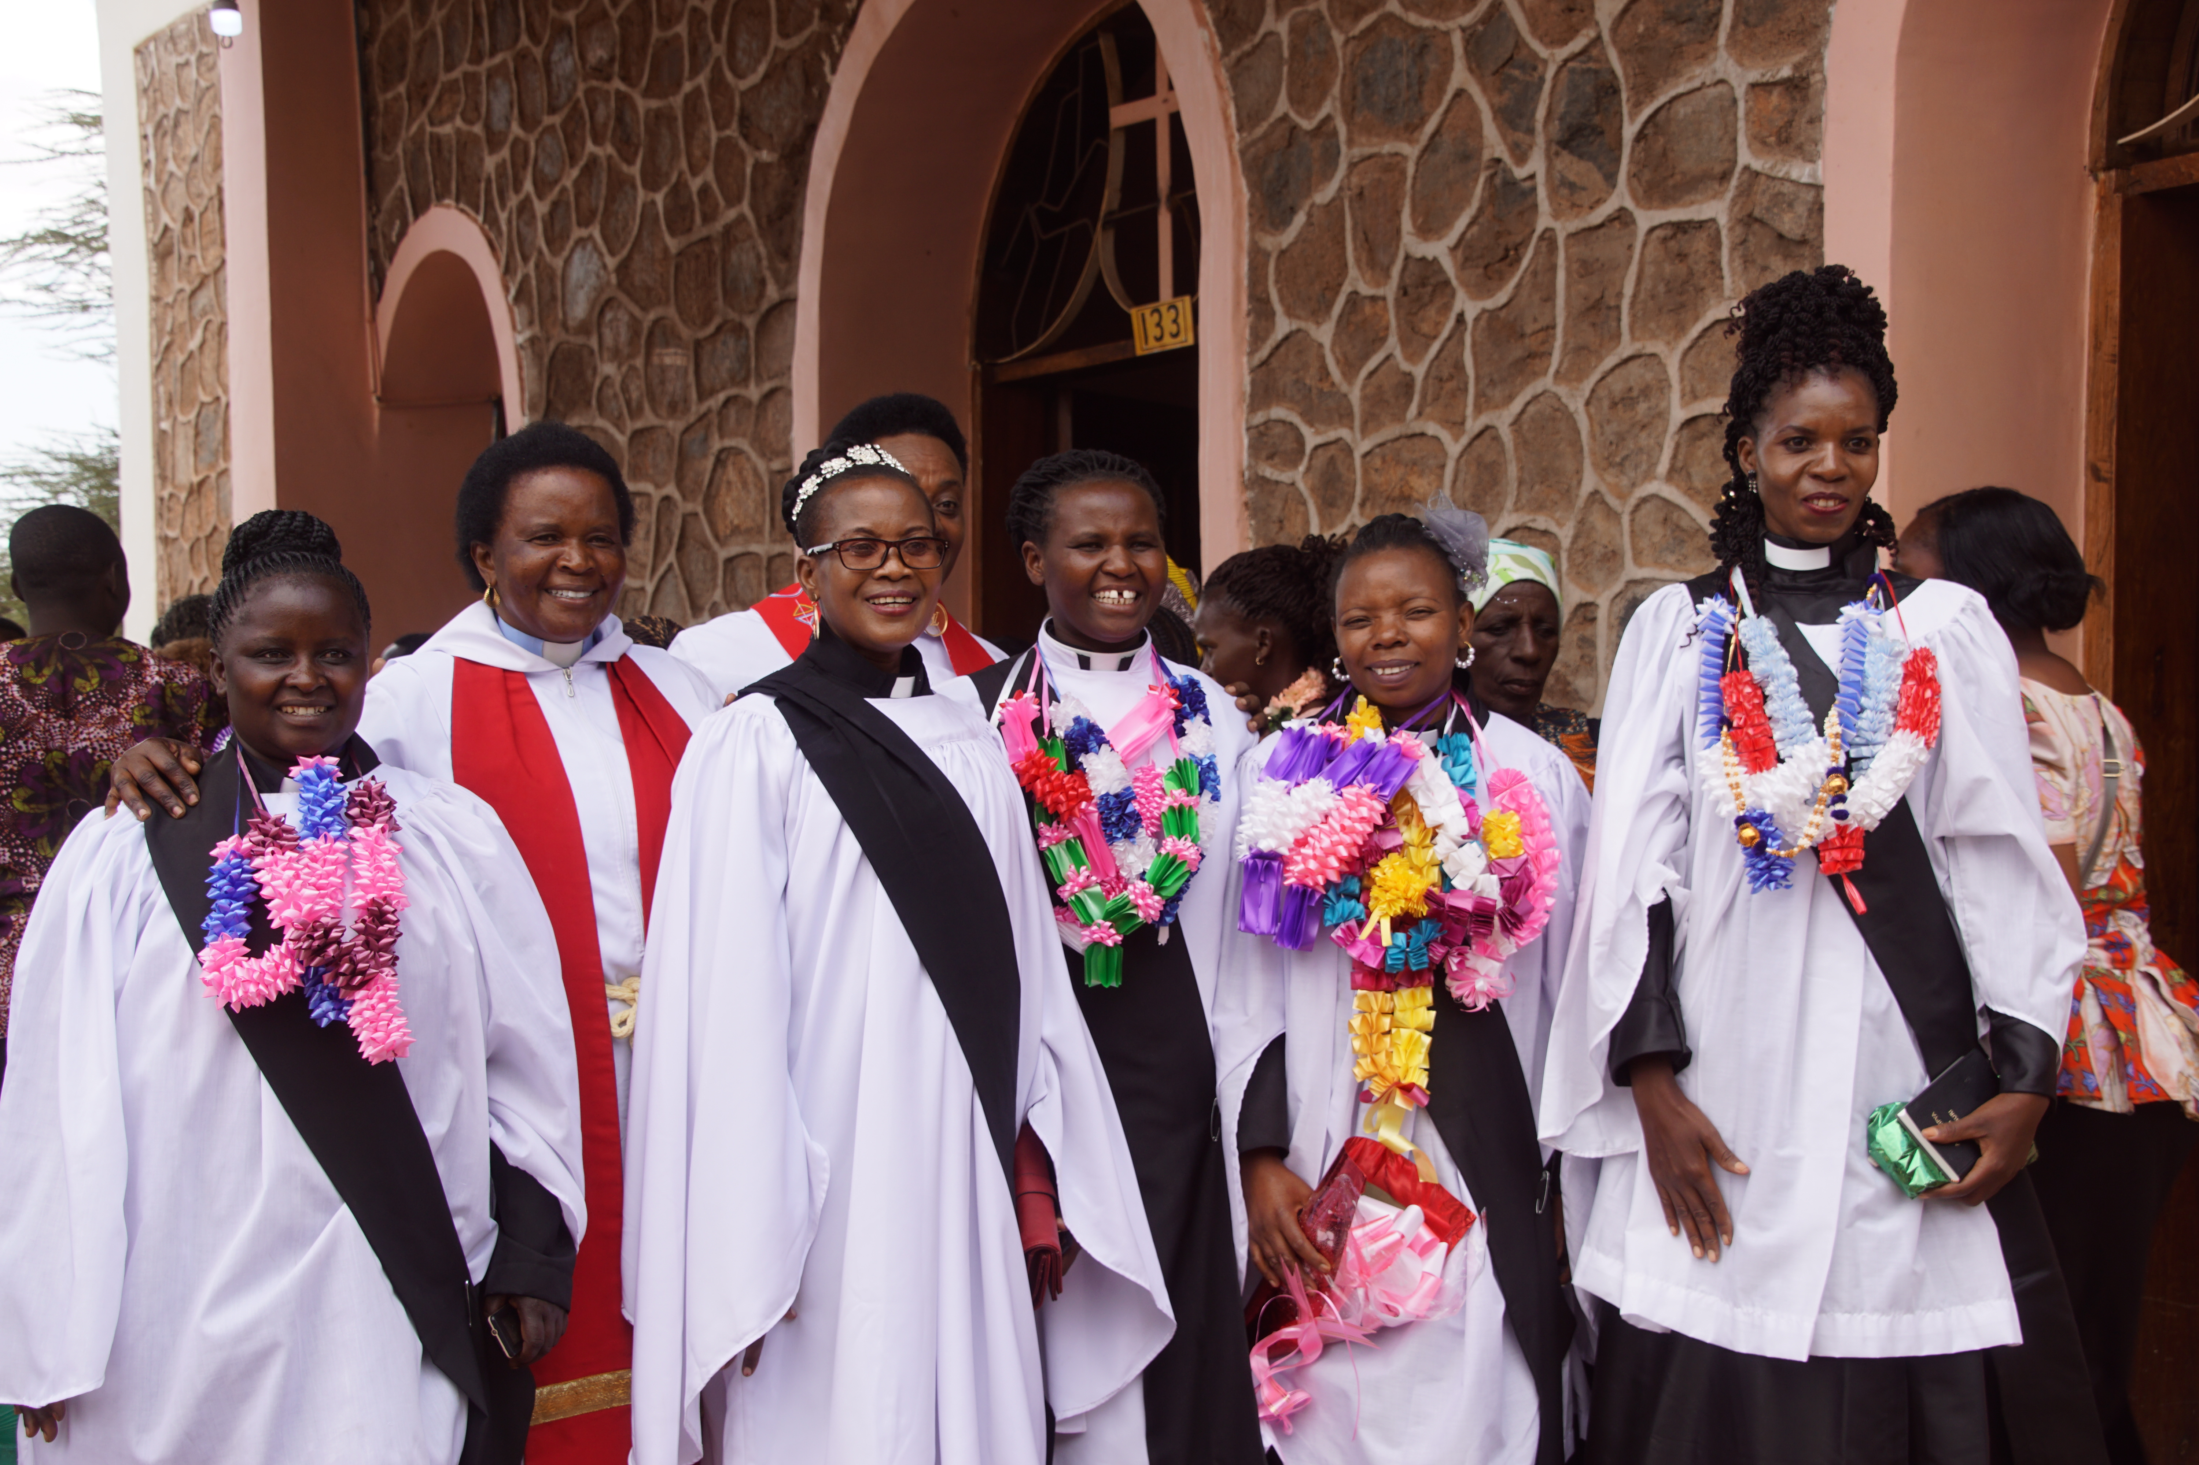
Residential student fees at the college Fees are £700 a year for a 3-year Diploma course.
Friends in Rochester currently support 2 students and their families who are studying for a Diploma in Theology. They will enter their last, third, year of study in August 23.

Slide 4
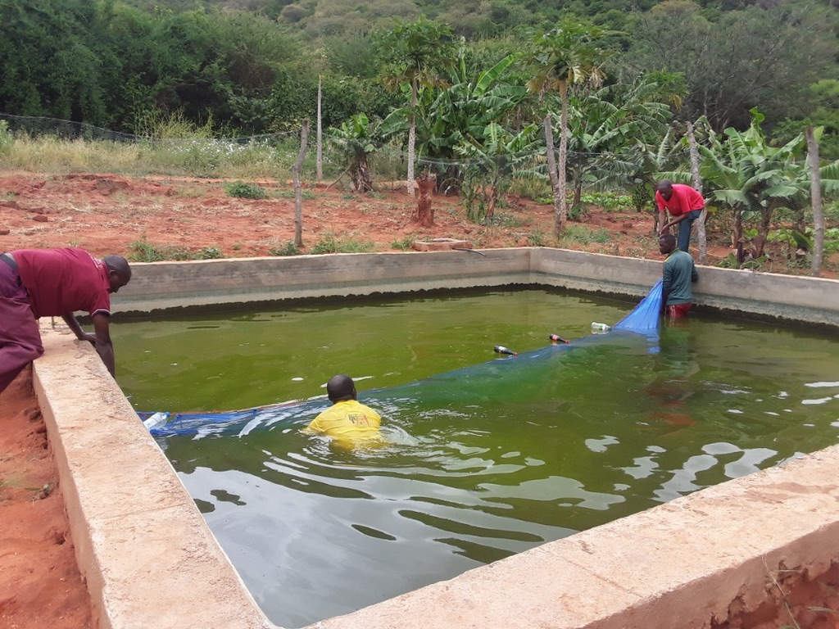
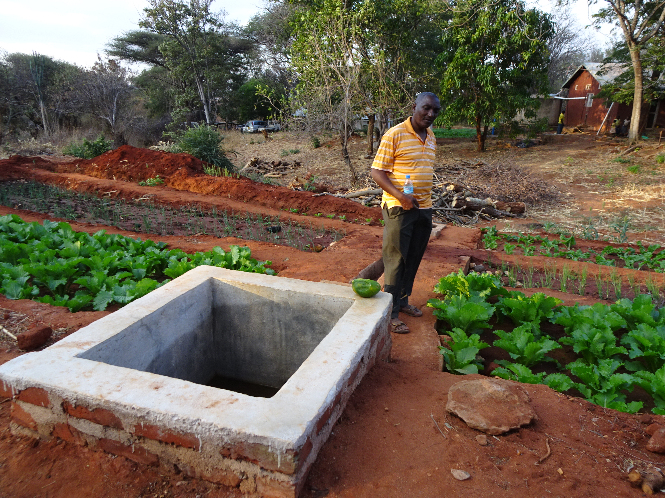

The staff and students at
St Philip’s have built a fish pond for tilapia! The project has proven so successful they now wish to build a second!
As fresh water is added, the soiled water is drained off every
4 to 5 days, this water is inturn channelled to various vegetable plots located further down the hillside!
Every drop counts

Slide 5
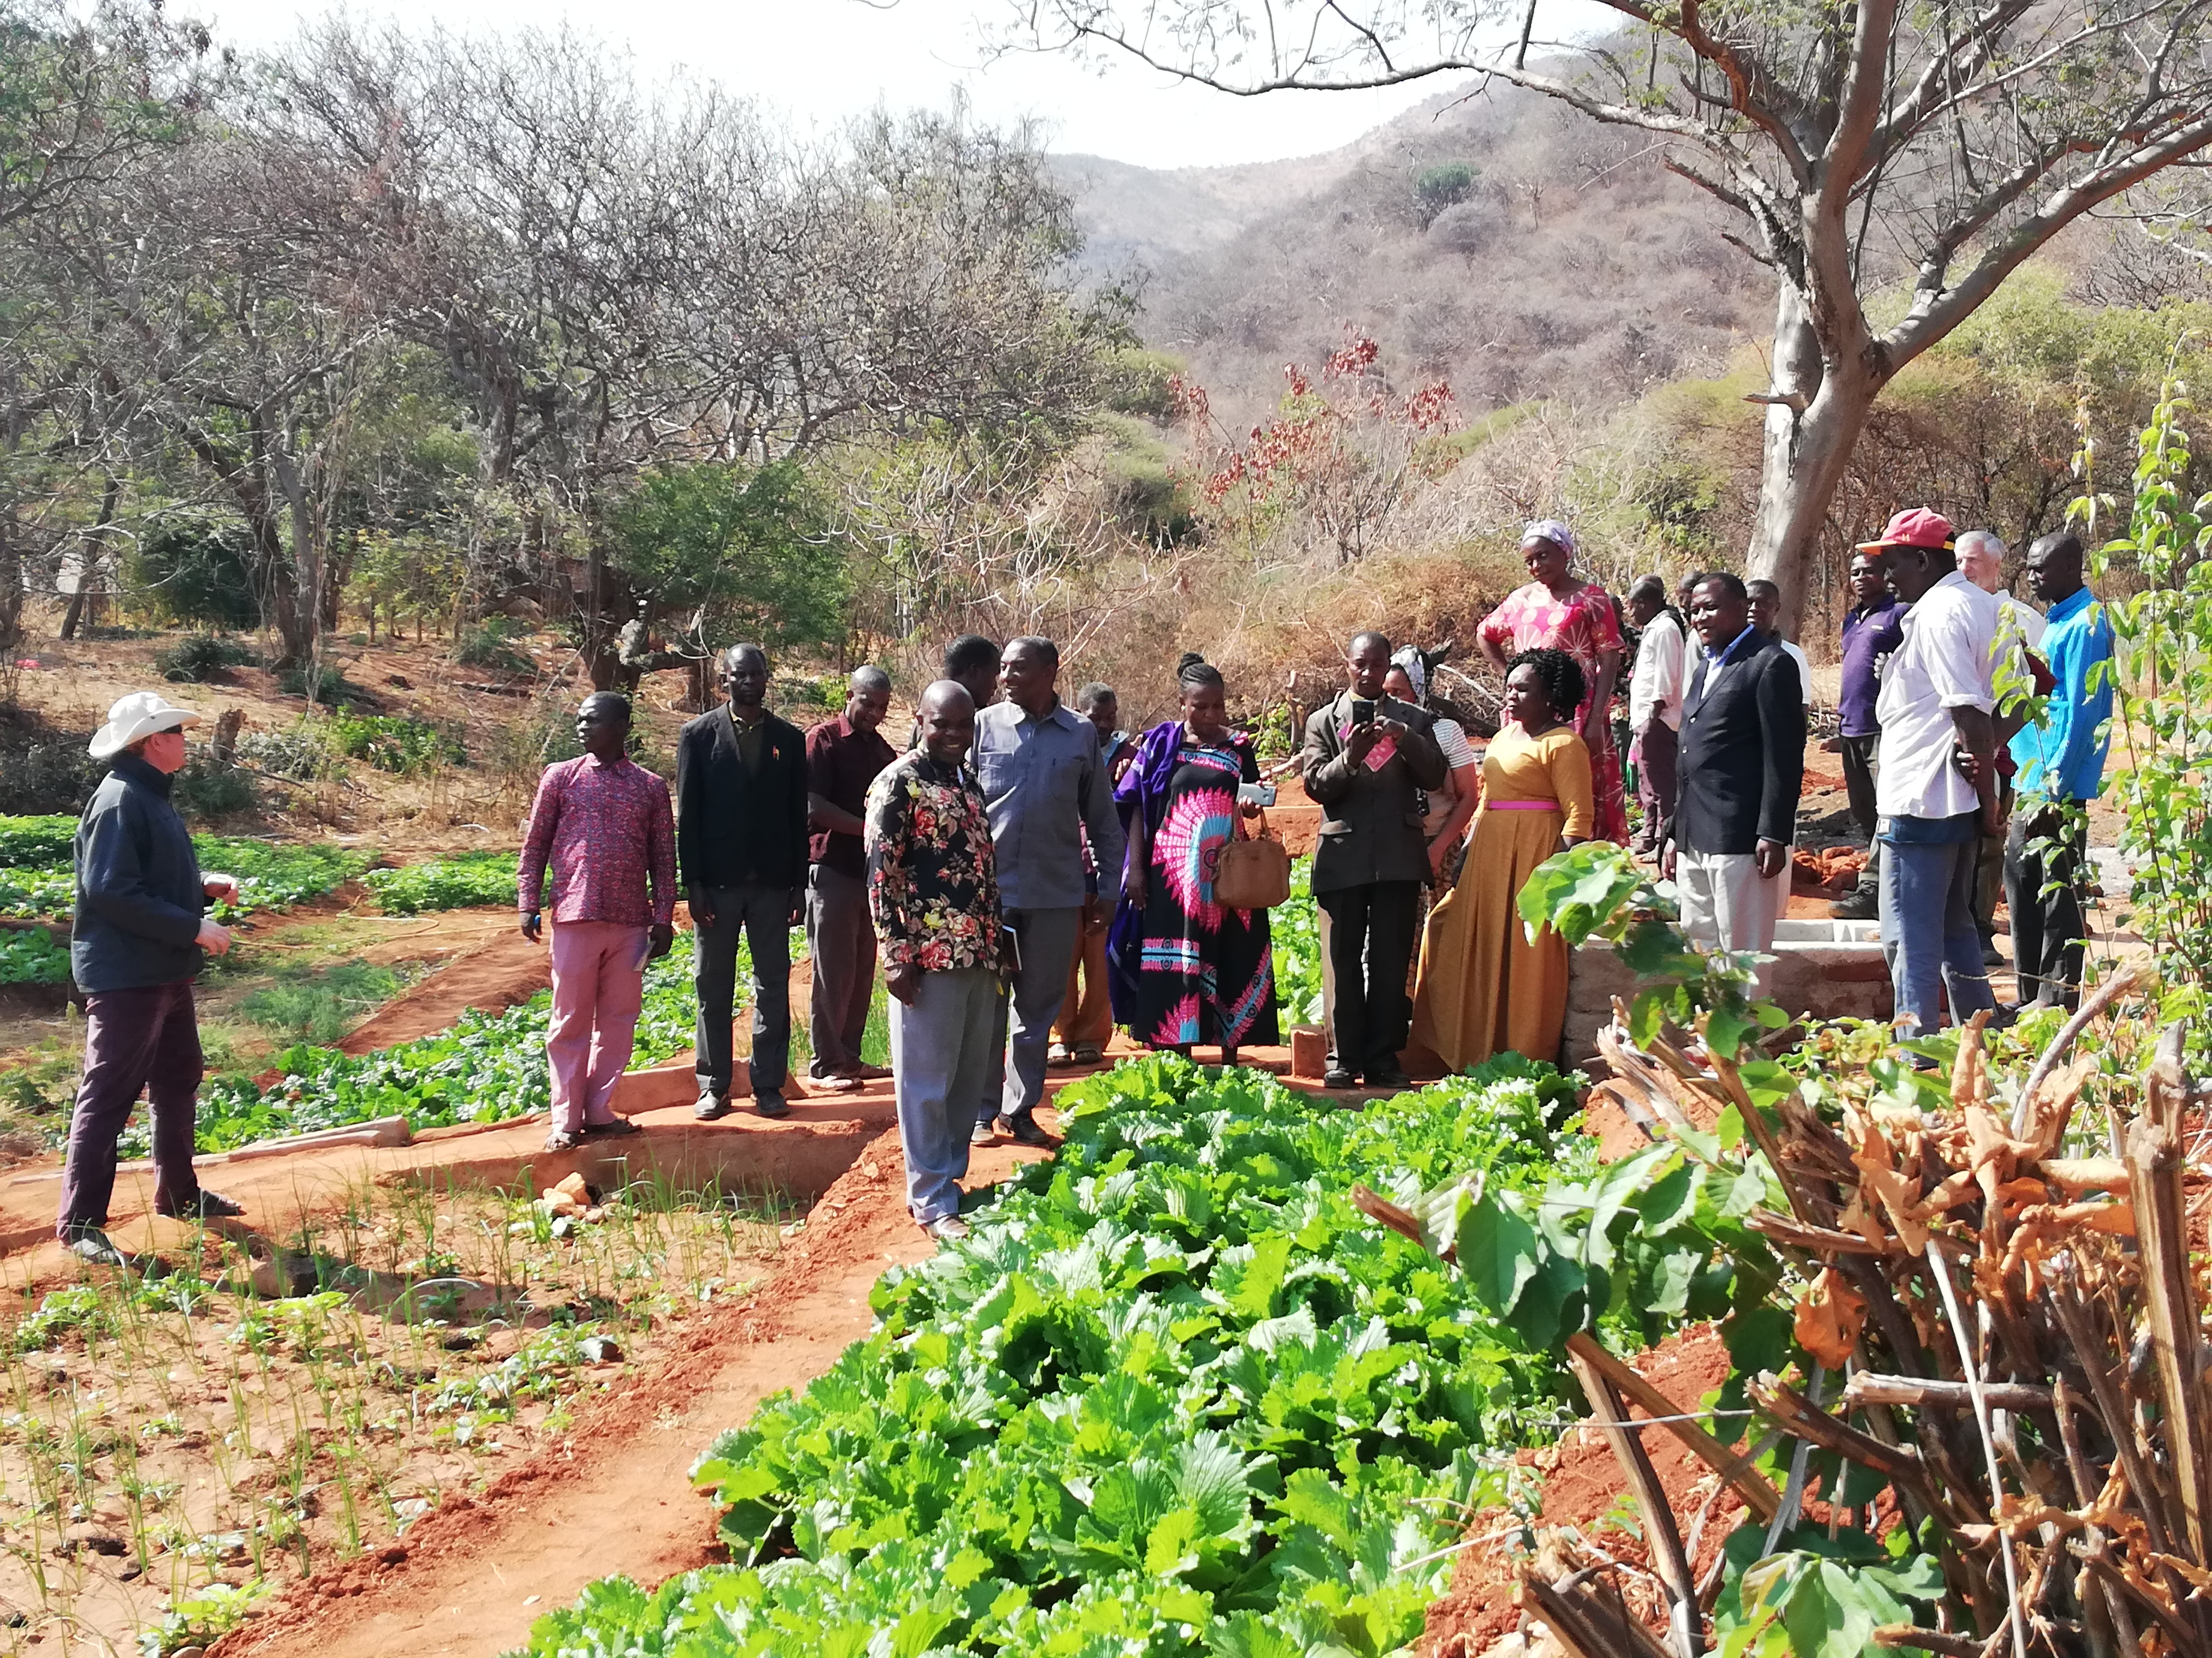
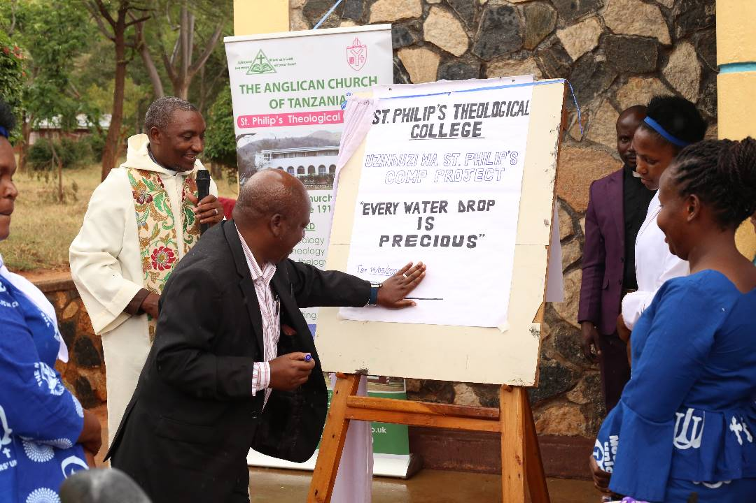
Agripa’s vision for
St Philip’s to be used as a training centre for micro and drip-irrigation projects (currently being introduced across the region) is now underway.
The first seminar was held in July 2023 with 30 delegates in attendance.

Slide 6
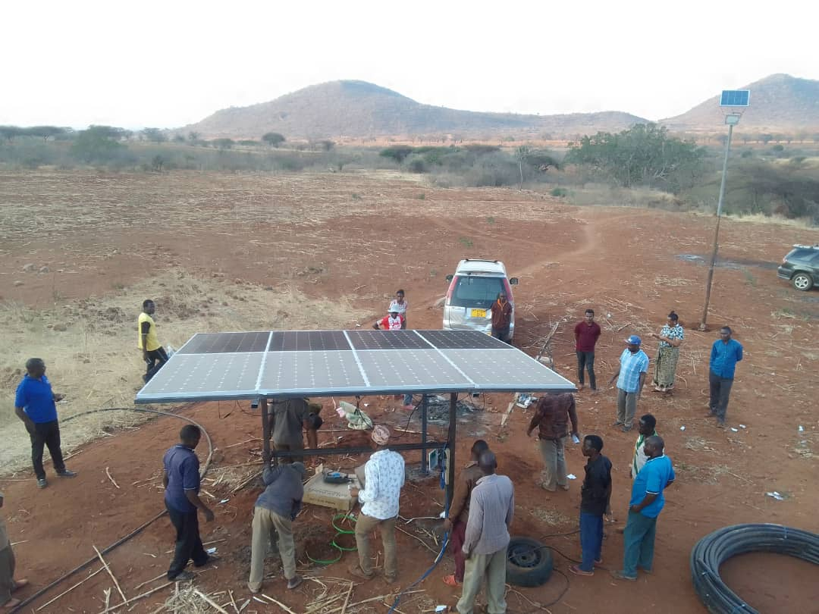
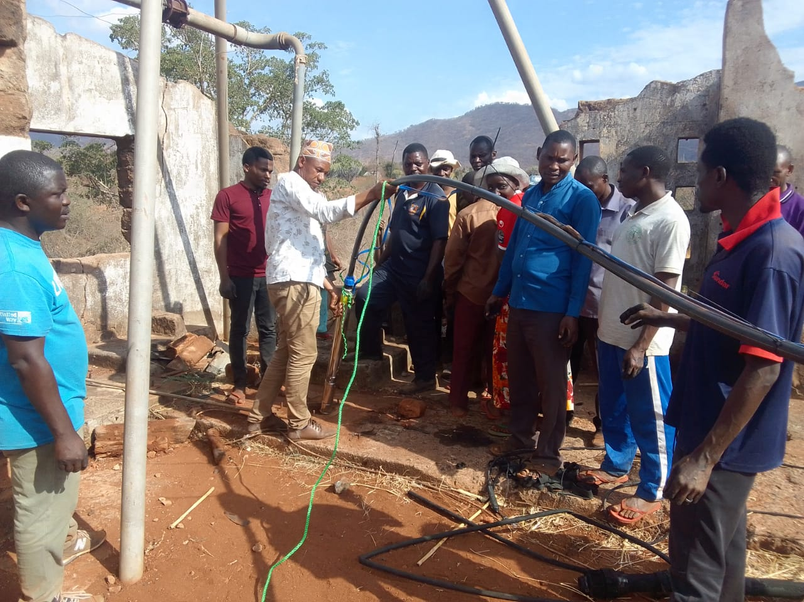
The 2022 Poverty and Hope grant enabled the college borehole to be adapted to use solar power with a new , larger pump installed.
Another friends of St Philip’s caught the solar vision, raising the additional funds needed to enable the next phase to begin straight away….

Slide 7
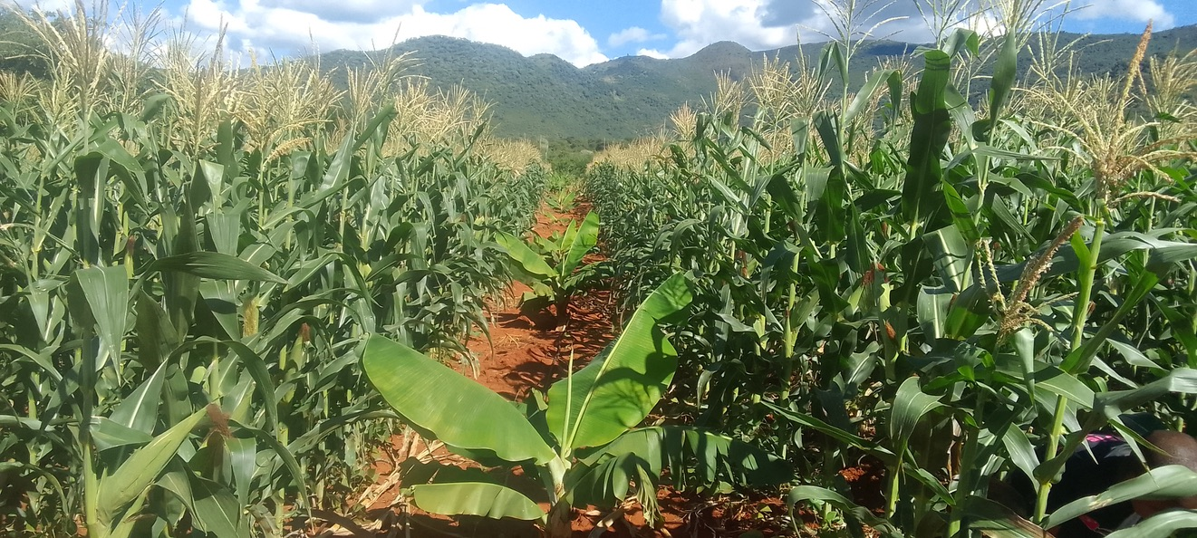
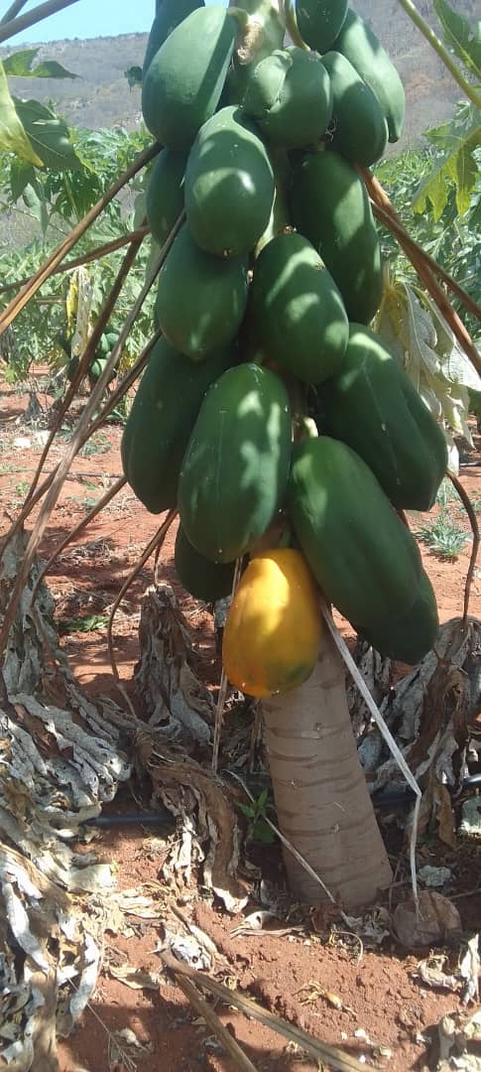
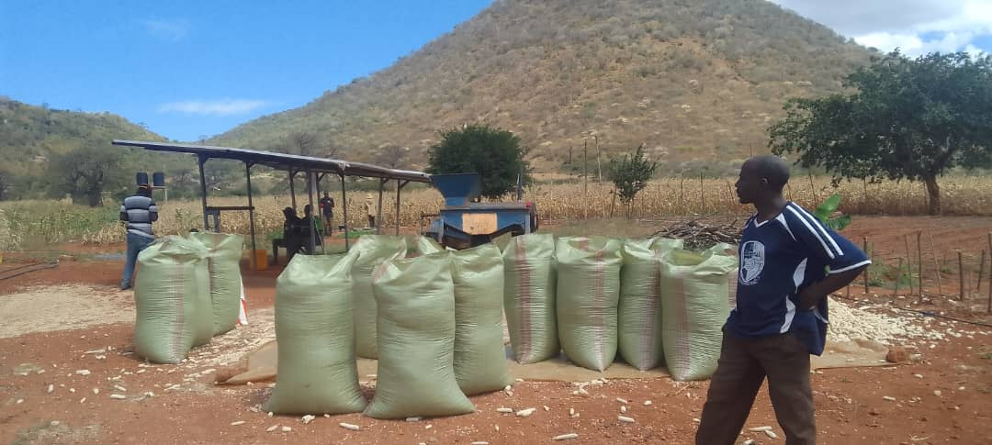
In an area where much of the maize harvest has failed due to lack of rain, the newly cleared (previously unused) land around St Philip’s has this year already produced 15 bags of maize - alongside other crops, including fruit from the hundreds of papaya trees planted.

Slide 8


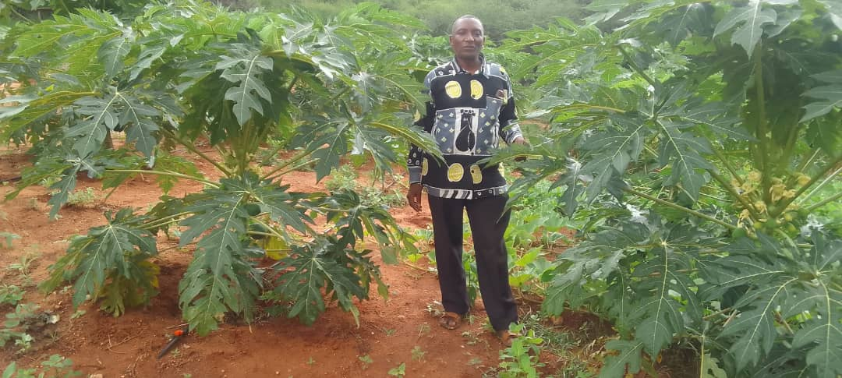




The college is now teaching on crop diversification…. No longer restricted to maize and sunflowers, today you will find onions, aubergines, tomatoes, sugar cane, mangos, oranges, cashew and other cash crops being grown across the community.

Slide 9
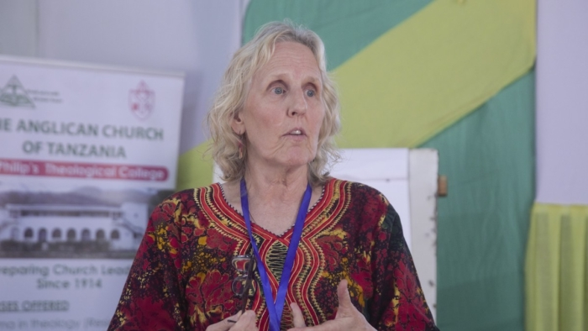
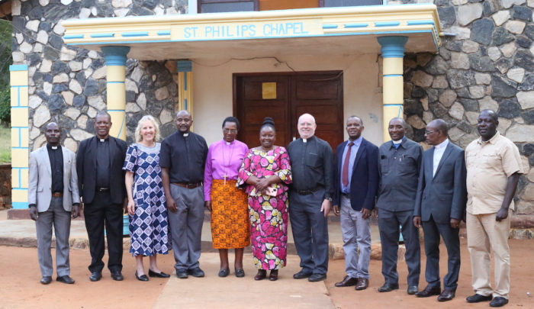
The Bethesda Disability Program, founded by Wendy Broadbent (pictured) is based at St Philip’s and is transforming religious beliefs and cultural attitudes towards disabilities.
St Philip’s recently hosted a 2-day workshop with heads of theological colleges in Tanzania, Kenya and Burundi. This groundbreaking work was reported in the national press.
To find out more about this program go to:
https://www.episcopalnewsservice.org/2023/07/03/anglican-communion-helping-african-children-with-disabilities-begins-by-refuting-cultural-religious-myths/

Slide 10
While Agripa was one of the three short-listed nominees for 4th Bishop of Mpwapwa, his service to the wider church at
St Philip’s is highly valued and appreciated.
Please continue to pray for Agripa and for his wife, Agnita.
We are grateful to Rochester’s CDSG Coordinator, Christine Allen, and also to Christina Parry, who are in discussion with
St Augustine’s Theological College (West Malling) about sharing resources, and for possible future visits of students to enhance their learning and to share with St Philip’s.

